Slide 1
Forests, Wildlife and Water
CHAPTER 16 Part 2

Slide 2
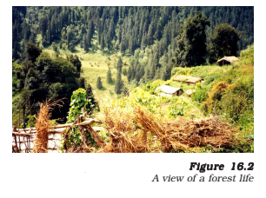
2. FORESTS AND WILDLIFE
Why are forests called biodiversity hotspots?
Forests are biodiversity hot spots.
Hotspot means an area full of biological diversity.
Loss of diversity may lead to a loss of ecological stability/ecological imbalance.
Notes:
Forests are biodiversity hot spots. Biodiversity of an area is the number of species of different life forms like bacteria, fungi, powering plants insects, birds, etc.
Hotspot means an area full of biological diversity.
Loss of diversity may lead to a loss of ecological stability/ecological imbalance.

Slide 3
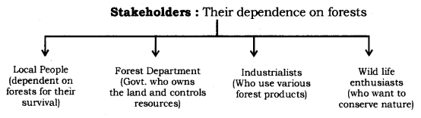
Stakeholders of wild life
A person having interest or concern for something is called as a stakeholder.
Notes:
A person having interest or concern for something is called as a stakeholder.
The stakeholders of forests are the local and tribal people of the area, the Forest Department of the Government, the industrialists and the wildlife and nature enthusiasts. Each of these groups of stakeholders make use of forests in different ways:
(i) The people who live in or around the forests are dependent on the forest products for various needs like shelter, food, transport, fuel, medicines and cattle grazing. After the British took control of the forests, these people were forced to depend on much smaller areas and forest resources started becoming overexploited to some extent.
(ii) The Forest Department of India destroyed the huge biodiversity of forests by converting them into monocultures of commercially important plants, such as pine, teak or eucalyptus. Such forests are useful for the industrial purposes and not for local needs.
(iii) Industrialists consider the forest as merely a source of raw materials for its factories. They are not interested in the sustainability of the forest in one particular area. They do not have any stake in ensuring that one particulate area should yield an optimal amount of some produce for all generations to come.
(iv) The wildlife and nature enthusiasts play an active role in conserving the forest in its pristine form

Slide 4
Forests are biodiversity hotspots. Biodiversity is defined as different types of organism present on the earth. The main aim of conservation is to preserve the biodiversity. The loss of biodiversity will lead to loss of ecological stability.
Stakeholders are local people, forest department, industrialists, and wild life enthusiasts.
Water is required for fulfilling the basic needs of individuals.
Coal and petroleum are non-renewable resource.
Disadvantages of fossil fuels
Notes:
We learned about forests. They are biodiversity hotspots, which is defined as different types of organisms present on earth. Forests needs to be preserved because loss of biodiversity will lead to loss of ecological stability.
People who are mostly affected by forests are called stakeholders, and they are local people, forest department, industrialist and wild life eenthusiasts.
Then we studied about water. It is a basic necessity. We also looked on how human activities have altered the availability of water in various regions. Rain in India are due to monsoon. Common irrigation methods such as dams, canals and tanks are used in various parts of India. These methods are maintained by local people. This helps in storing water which can be used in agriculture. Not only in agriculture, daily needs of the common people can be met through this water.
Then we also discussed about non-renewable energy sources like coal and petroleum, how they are being excessively used at very high rates and its hazardous effects.
We concluded the chapter by discussing about the ways to minimize fossil fuels.
Thank you.

Slide 5
3. WATER FOR ALL.
Water is a basic necessity as we need it for fulfilling our needs.
3.1 What are dams?
- Irrigation methods like dams are used in various parts of India.
- Large dams serve dual purpose of irrigation and electricity geneartion.
- The mismanagement of large dams and canal systems leads to unequal distribution of water and its benefits.
Notes:
Water is a basic necessity as we need it for fulfilling all our needs.
Rains in India are largely due to monsoons which is available only for a few months of the year.
Irrigation methods like dams, tanks and canals have been used in various parts of India since ancient times. The management of all these water resources was carried out locally and optimally, according to the agricultural and daily needs of the local people.
Large dams serve dual purpose of irrigation and electricity generation. The canal systems leading from these dams can transfer large amounts of water to great distances, e.g., the Indira Gandhi Canal in Rajasthan.
The mismanagement of large dams and canal systems leads to unequal distribution of water and its benefits. Therefore, building large dams brings about several social, economic and environmental problems.

Slide 6
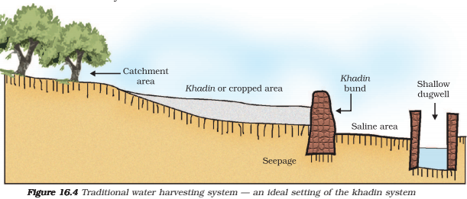
3.2 Ancient method of watershed management system
- Water harvesting is an age-old concept in India.
- One of the method is known as Khadins in Rajasthan
Notes:
Water harvesting is an age-old concept in India.
Restoring the ancient water harvesting systems has recharged ground water levels and is a viable option to the large scale water storage projects.
Different methods of watershed management system are known since ancient times. One of the method known as Khadins in Rajasthan which consists of a long earthen embankment built across the lower hill slopes. The area enclosed by the embankment is called as ‘bund’ which collects huge amount of rainwater which flows down the slopes. Subsequently this water saturated land is used for crop production.

